Slide 1



M.A.M. SCHOOL OF ENGINEERING
(Accredited by NAAC)
(Approved by AICTE-New Delhi || Affiliated to Anna University-Chennai)
Siruganur, Tiruchirappalli-621105
Department of Computer Science Engineering
Academic Year 2024-2025 (EVEN)
DDoS ATTACK PREDICTION USING
MACHINE LEARNING
Under the guidance of
Prof C.CHITHRA M.E,
Supervisor,
Department of Computer Science and Engineering,
M.A.M. School of Engineering.
Siruganur, Trichy-621105.
Presented by :
MOHAMED YUSUF M - 812121104032
NAGARJUN B N - 812121104035
PAZHANIBHARATHI S - 812121104041
SARAVANAKUMAR M - 812121104050

Slide 2
INTRODUCTION:
2
Distributed Denial of Service attack(DDoS) is one of the most dangerous attack in the field of network security.
It is an attack which coordinated stream of request is launched against from many locations at a same time.
These attacks are increasing day by day and have become more sophisticated. So, it has become difficult to detect these attacks and secure online services.

Slide 3
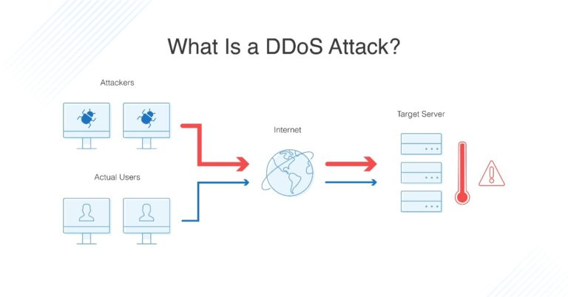
Many of the organizations like github, aws get affected due to the DDoS attack.
So, there is a need to detect the DDoS attack Hence, we propose a system to predict these attacks using machine learning algorithm.

Slide 4
OBJECTIVE:
4
The Main goal of this project is to detect the DDoS attack using machine learning algorithm such as Random Forest algorithm.

Slide 5
LITERATURE SURVEY:
1.TOPIC : Predicting DDoS attacks.
DISCUSSION:
In this model, they detect and analyze the DDoS attacks in cloud computing using Dempster-Shafer Theory(DST) operations in 3-valued logic and the fault tree analysis for each VM-based IDS.
CONCLUSION:
In this work, they focused on only a particular environment that is cloud computing and context-aware mechanism is needed.

Slide 6
2.TOPIC: Detecting DDoS attacks using Data Mining Techniques.
DISCUSSION:
In this model, the DDoS attack can be detected using IDS (Intrusion Detection System) technique.
This model has achieved the accuracy of 89% to 90%.
CONCLUSION:
In this work, they only concentrated on network layer and application layer. This model has achieved less accuracy compared to others.

Slide 7
3.TOPIC: Research and implementation of DDoS attack based on machine learning in distributed environment.
DISCUSSION:
In this model, they detect the DDOS attack by using various machine learning algorithm in distributed environment.
CONCLUSION:
Context of the data stream is not fully used.

Slide 8
4.TOPIC: A Survey of defence mechanism against DDoS flooding attack.
DISCUSSION:
In this model, they classify various DDoS detection mechanism.
CONCLUSION:
Compare various defence mechanism performed at network/transport level, application level but effective solution is missing.

Slide 9
EXISTING SYSTEM:
7
In the previous model DDoS attack can be detected by using SVM algorithm.
This model has achieved a remarkable accuracy of 85%.
DRAWBACK:
One of the disadvantage of SVM is that it may not perform well with very large datasets or datasets with high degree of noise or overlapping classes.
The potential disadvantage of SVM is that it may have a higher false positive rate.

Slide 10
PROPOSED SYSTEM :
7
In this project, we design a web page for predict the DDoS attack based on the features extract from the dataset.
We used a well known supervised machine learning model.
Random forest can overcome the issue faced in existing system by combining multiple decision trees and using voting system to classify network traffic.

Slide 11
FLOWCHART:
Input
DDoS Dataset
Data pre-processing
Data
Visualization
Random forest algorithm
Predicted output
Trained Model
Test Data

Slide 12
MODULES:
Data Collection
Data Preprocessing
Data Visualization
Train the model
Result analysis

Slide 13
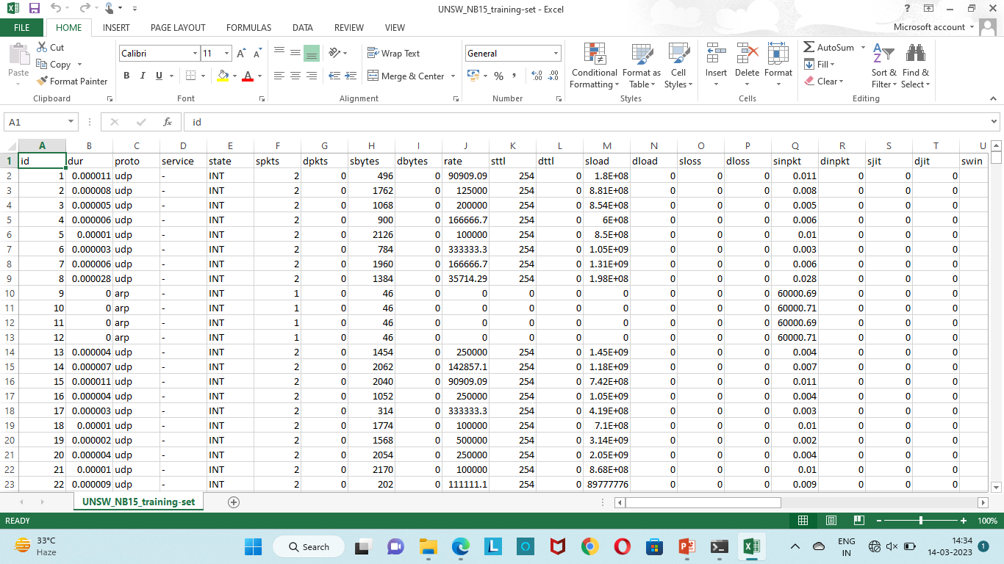
DATA COLLECTION:
In this project, we used the UNSW-NB-15 Dataset, that contain the different features about the DDoS attack including ID number, protocol, duration, attack_cat which presents the severity of the DDoS attack.

Slide 14
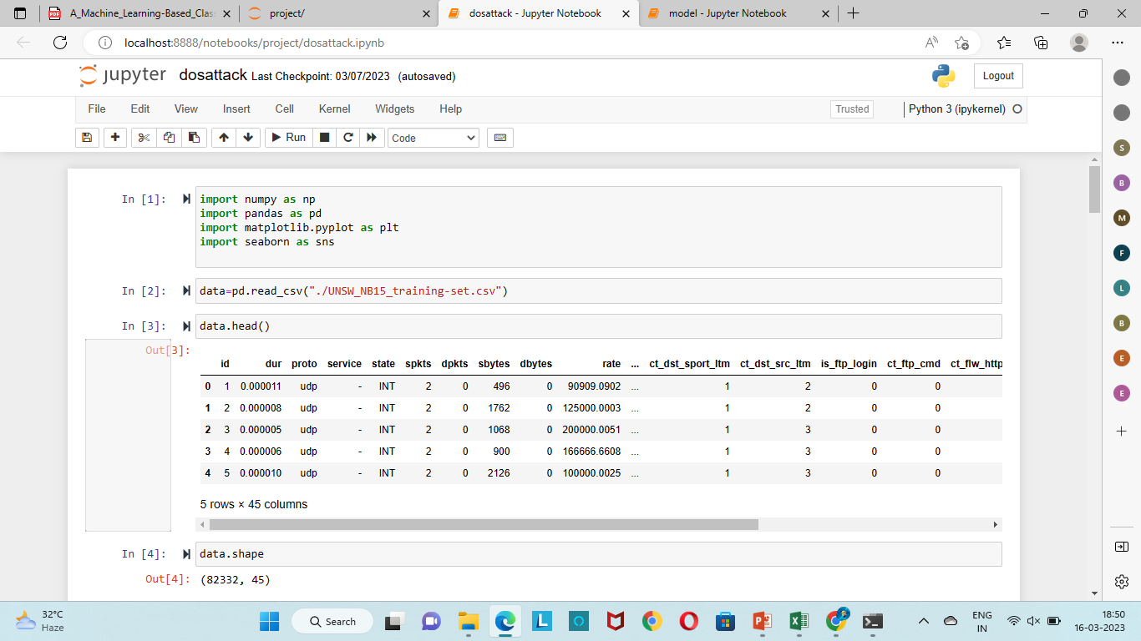
READING THE DATASET:

Slide 15
DATA PREPROCESSING:
In this module, we are going to clean the information from irrelevant data and convert it to quality information.
For this step we are using some techniques to clean data and replace those values which are not important in our experimental analysis.

Slide 16
BEFORE PREPROCESSING:

Slide 17
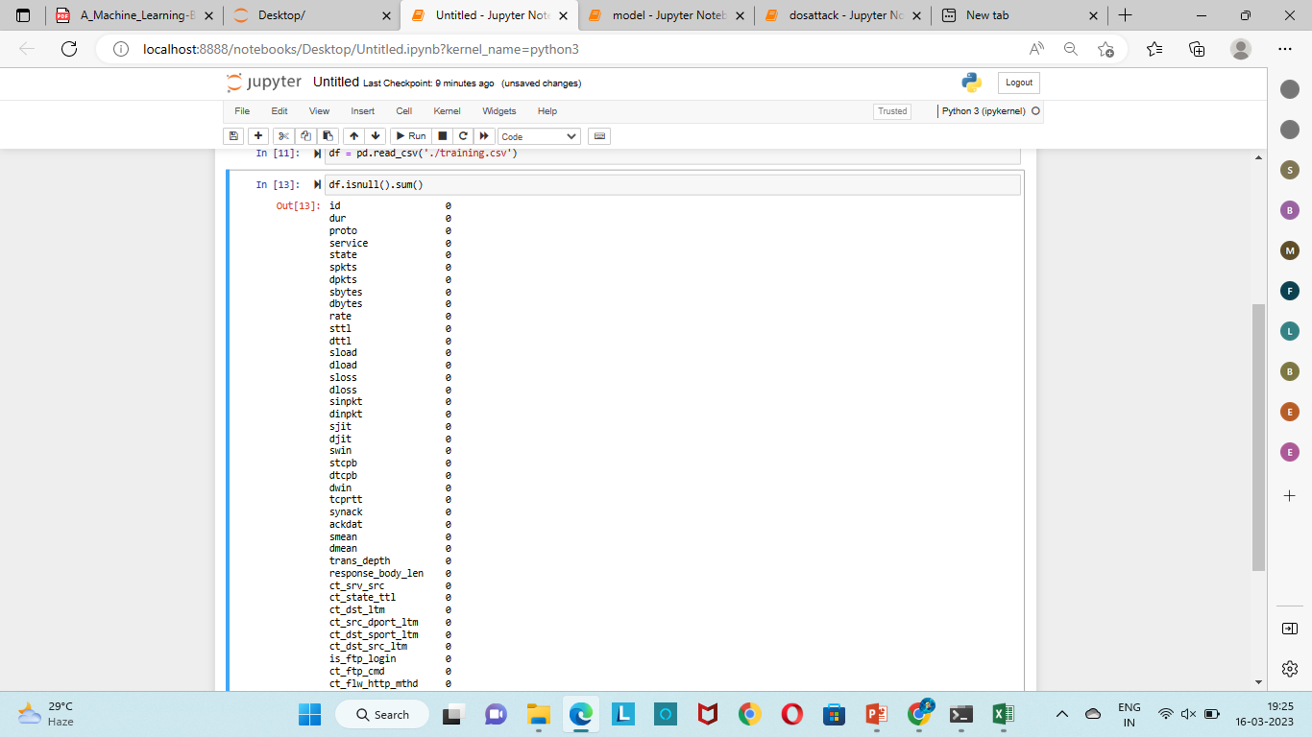
In this step, we check whether the missing value is present or not.

Slide 18
Then convert the categorical values into numerical values such that UDP as 77 and TCP as 111.
And also, we replace the ‘ – ’ of service attribute into corresponding values such that,
UDP DNS
TCP HTTP
Consider DNS as 0 and HTTP as 5

Slide 19
The HTTP requests are work by using TCP because it verifies that
data is delivered across the network accurately and in the proper
sequence.
The DNS requests are generally very small and fit well within
UDP protocol. So, we replace DNS for UDP protocol.

Slide 20
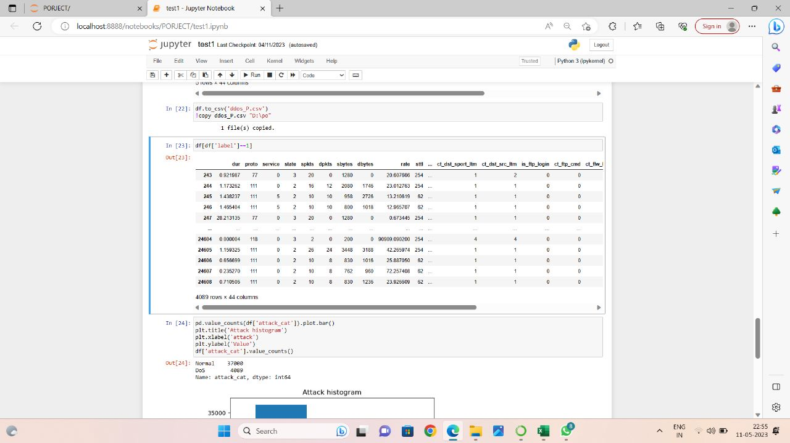
AFTER PREPROCESSING:

Slide 21
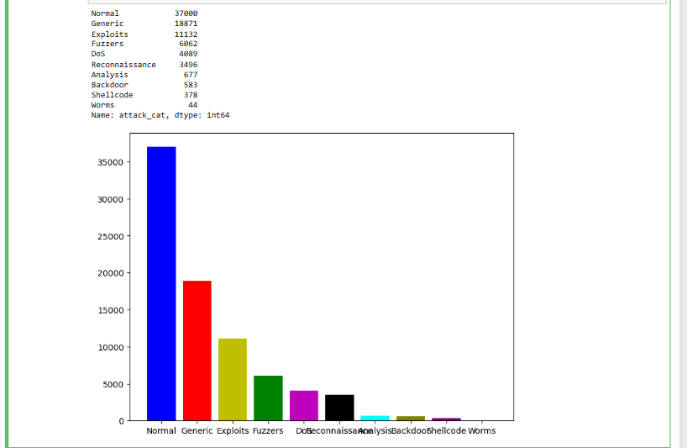
DATA VISUALIZATION:
The present of data where the information will understandable in the form of image or diagram.
This step is used for selecting the test class and this step is very important to understand data in a much better way.

Slide 22
TRAIN THE MODEL:
In this step, we train the training datasets using Random forest algorithm.
It consists of two steps. They are,
i) Classification Result
ii) Confusion matrix
Connecting the web page to the trained model.
Predict the results.

Slide 23
CLASSIFICATION RESULT:
It create a combination of decision tree by selecting those
important features to predict the DDoS attack.
Those features are:
i)Total duration
ii)Source Bytes
iii)Destination Bytes
iv)Source Time to Live
v)Destination Time to Live

Slide 24
REASON FOR SELECTING THESE FEATURES:
FEATURES | ATTACK | NORMAL
Total Duration | <=1 sec | >1 sec
Source Bytes | <=1000 bytes | >1000 bytes
Destination Bytes | <=500 bytes | >500 bytes
Source Time to Live | <=254 bytes | >254 bytes
Destination Time to Live | <=252 bytes | >252 bytes

Slide 25
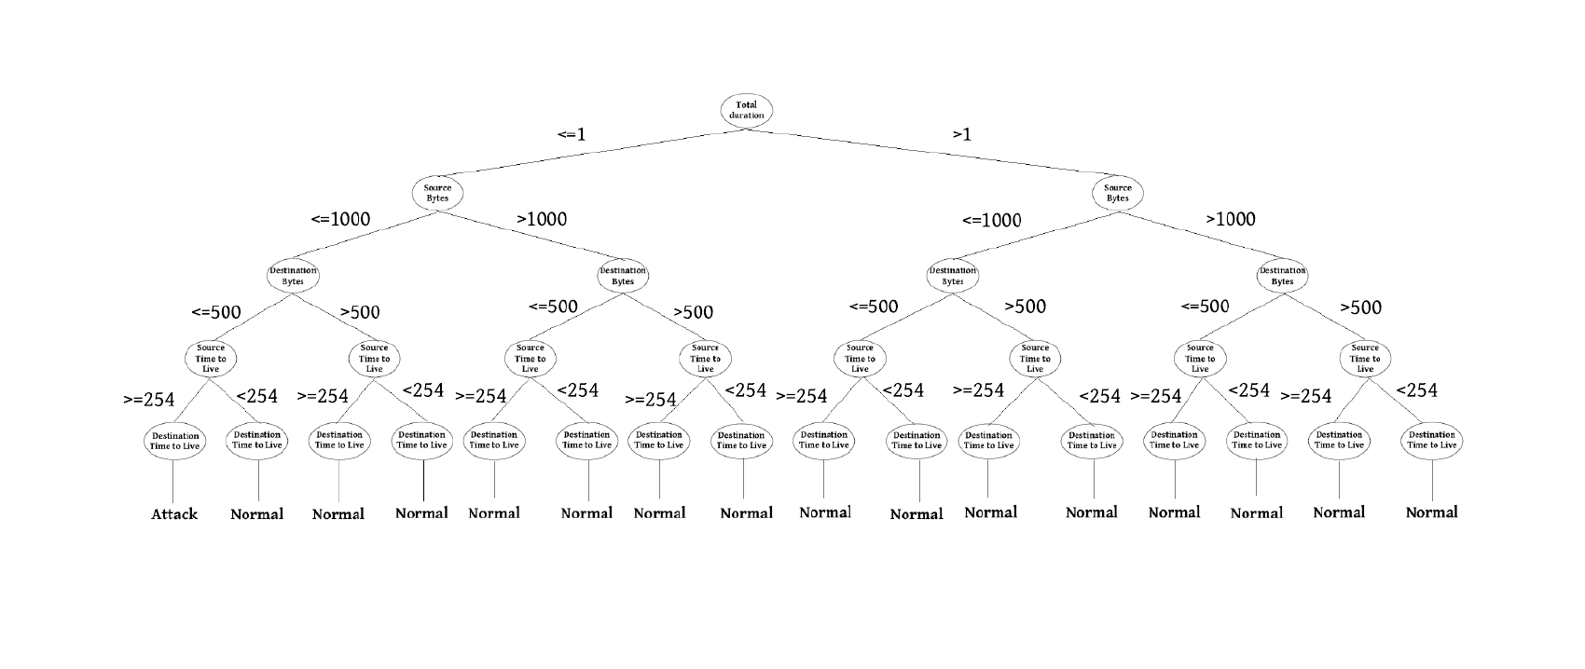
DECISION TREE :

Slide 26
CONFUSION MATRIX :
The confusion matrix denotes the overall number of actual and
predicted labels for a particular algorithm.
It is used to calculate the accuracy of the representation, just like
arranging true and prescient marks.

Slide 27
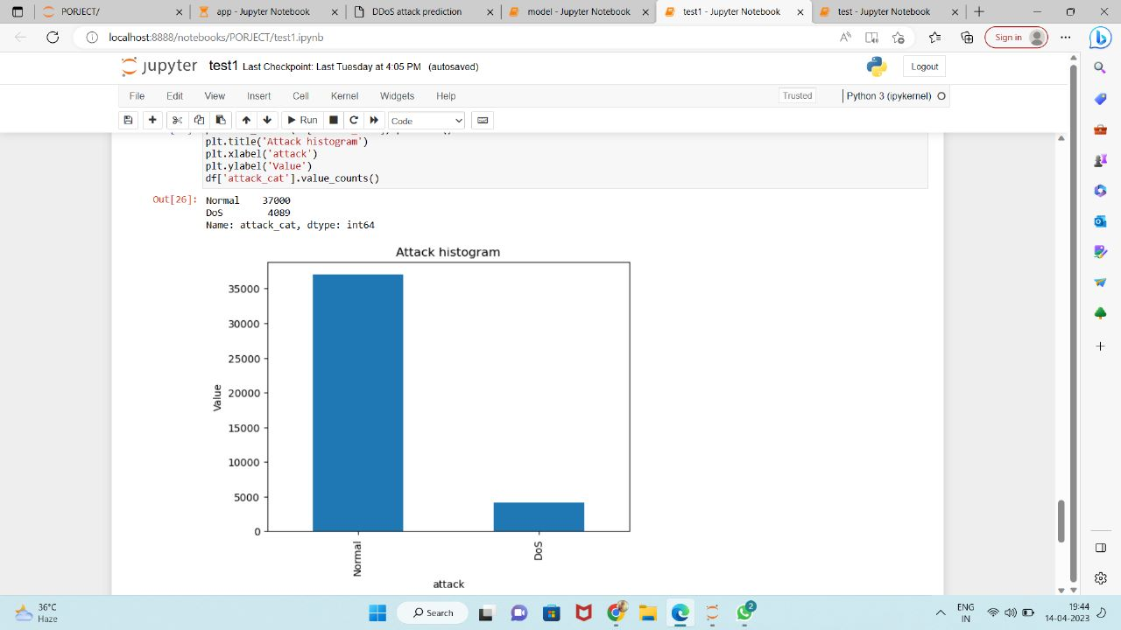
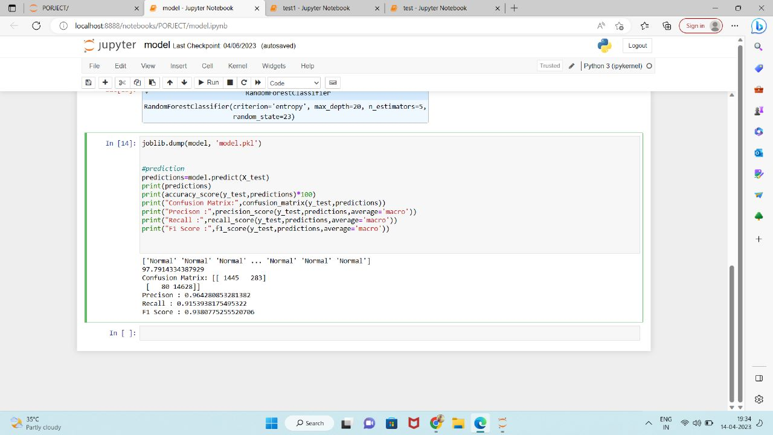

Slide 28
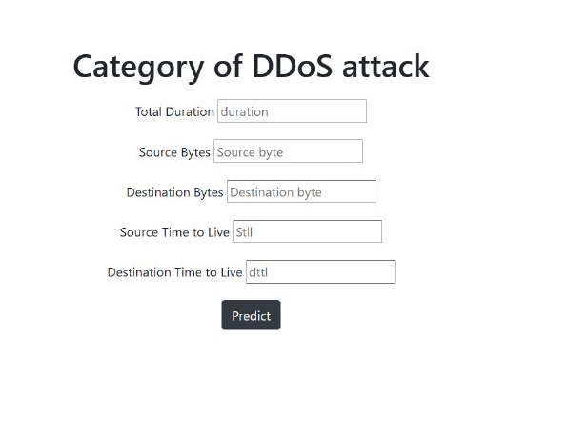
CREATING A WEB PAGE

Slide 29
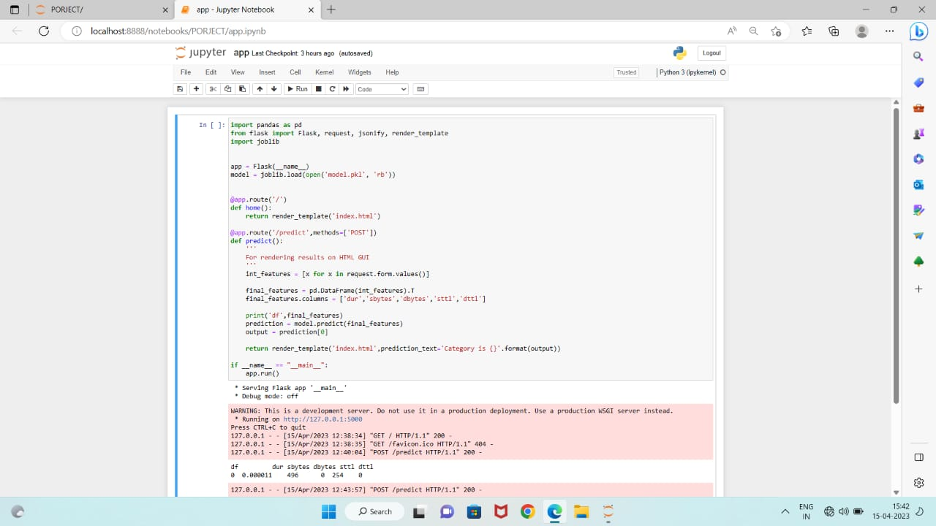
CONNECTING THE WEB PAGE TO THE TRAINED MODEL
In this step, we connect the web page to the trained model by using
Python flask.

Slide 30
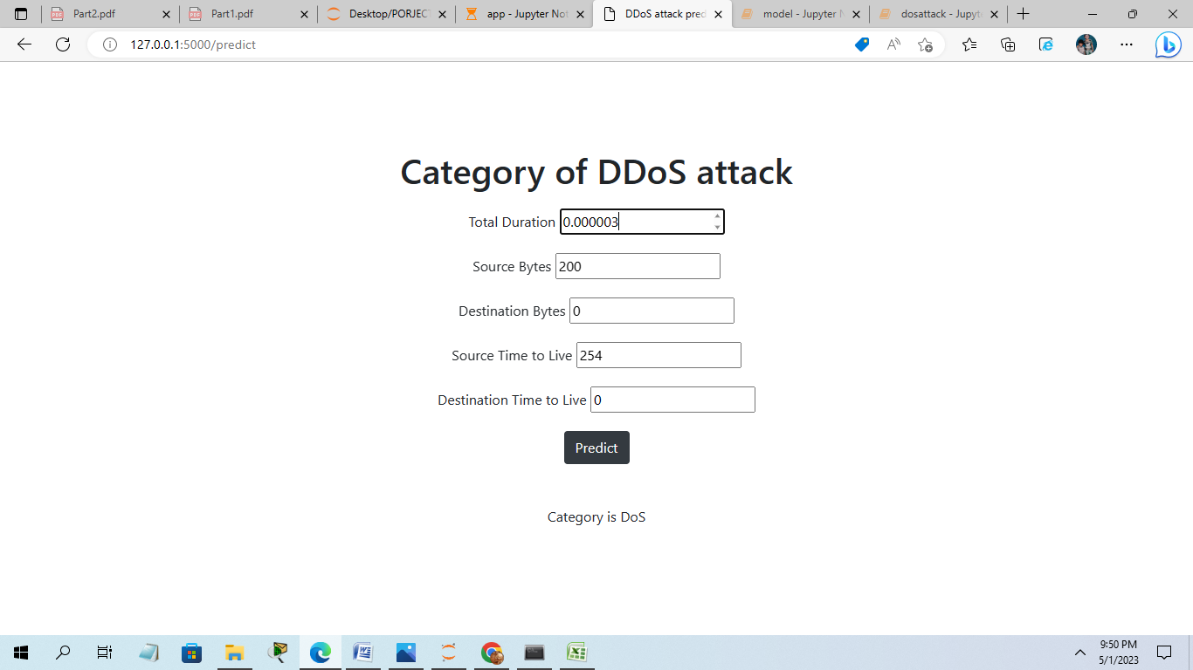
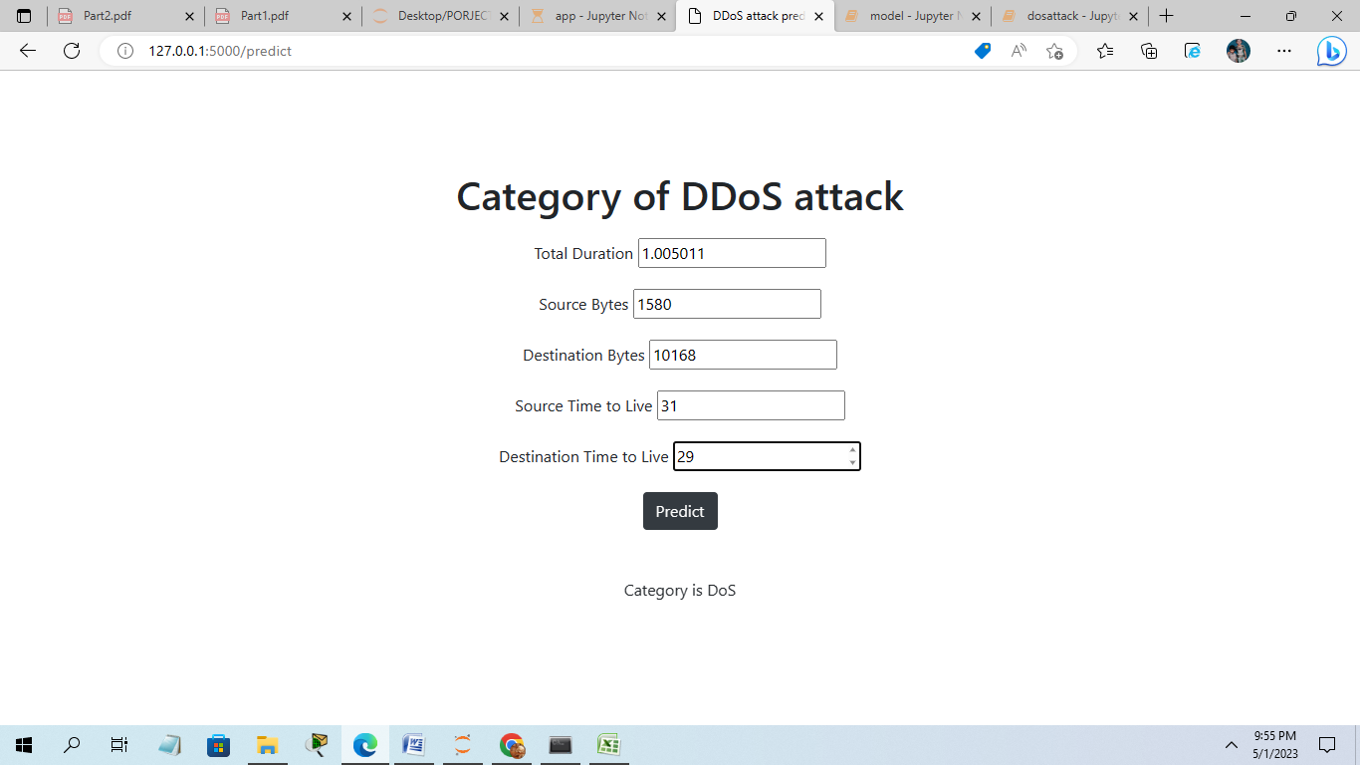
RESULT ANALYSIS

Slide 31
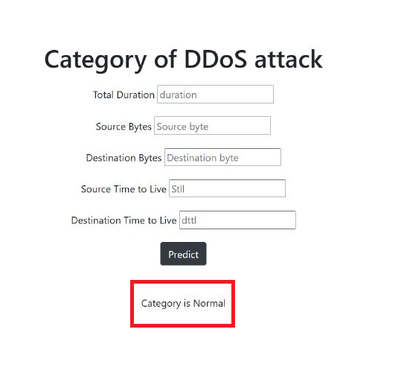


Slide 32
The Random forest, which is one of the most popular and powerful machine learning classification algorithm.
It can apply for both classification and regression problems.
It is based on ensemble learning, which integrates multiple classifiers to solve a complex issue and increases the model's performance.
RANDOM FOREST CLASSIFIER:

Slide 33
Random Forest is a classifier that contains several decision trees on various subsets of a given dataset and takes the average to enhance the predicted accuracy of that dataset.
Instead of relying on a single decision tree, the random forest collects the result from each tree and expects the final output based on the majority votes of predictions.

Slide 34
WORKING OF RANDOM FOREST ALGORITHM:
It is implemented in two phases:
The first is to combine N decision trees with building the random forest.
The second is to make predictions for each tree created in the first phase.

Slide 35
The following steps can be used to demonstrate the working process:
Step 1: Pick M data points at random from the training set.
Step 2: Create decision trees for your chosen data points (Subsets).
Step 3: Each decision tree will produce a result. Analyze it.
Step 4: For classification and regression, accordingly, the final output is based on Majority Voting or Averaging, accordingly.

Slide 36
24
THANK YOU

